Slide 1
Weather Forecasting using Probabilistic Graphical Models
Spring 2014 – Probabilistic Graphical Models (10708)
Felipe Hernández and Amos Ng
Professor: Eric Xing
TA mentor: Dai Wei

Slide 2
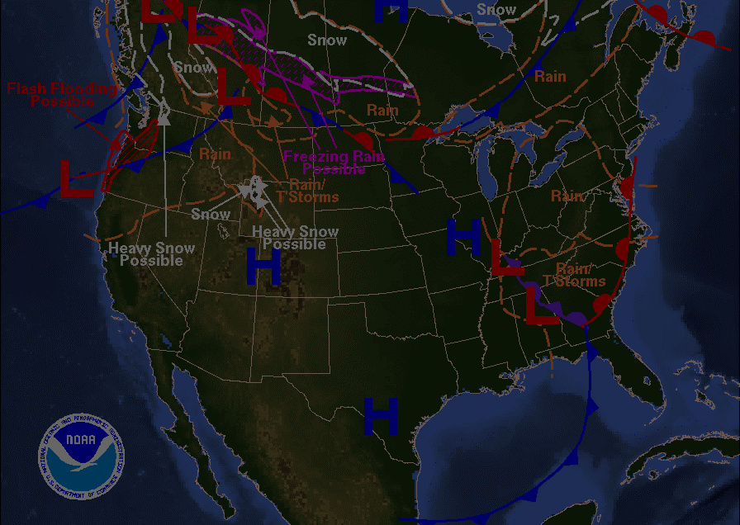
Weather forecasting
Physically-based global models
Physically-based local models
Artificial Neural Networks (ANN)
Fused ANN: support vector regression, particle swarm optimization, genetic algorithms, etc.
ANN-based: neuro-fuzzy models (NFM)
Fused NFM: wavelet transforms, genetic programming, etc.
Linear regression, discriminant analysis, logistic regression, etc.

Slide 3
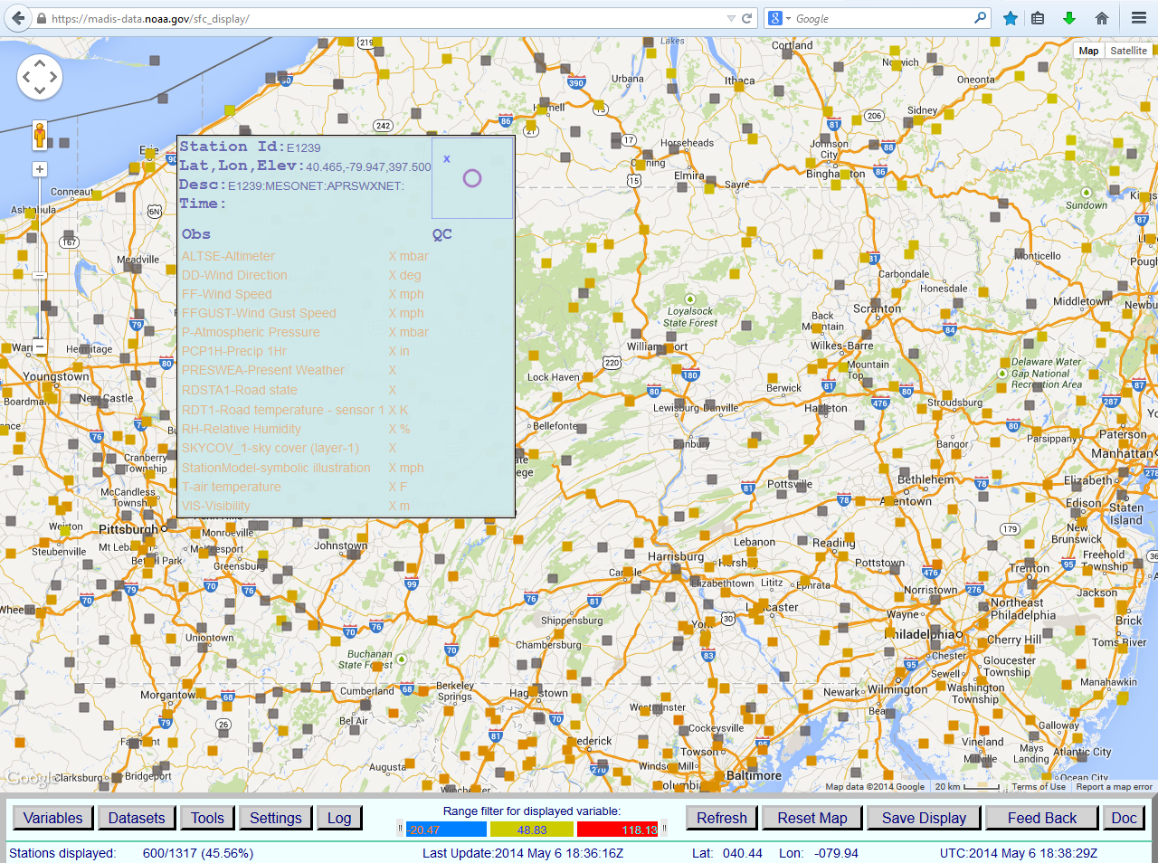

Slide 4
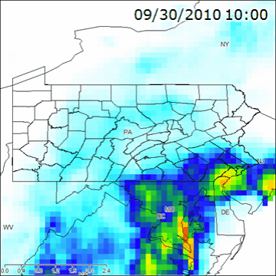
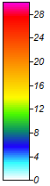
NLDAS-2 dataset
1 hour accumulated rainfall (mm)

Slide 5
NLDAS-2 dataset
Name | Description | Units
precipitation | Accumulated height of precipitated water column | millimeters
available potential energy | 180-0 mb above ground Convective Available Potential Energy | Joules per kilogram
% convective precipitation | Fraction of total precipitation that is convective | none
LW radiation | Long wave radiation flux downwards (surface) | watts per square meter
SW radiation | Short wave radiation flux downwards (surface) | watts per square meter
potential evaporation | Potential evaporation | millimeters
surface pressure | Surface pressure | pascals
specific humidity | 2 m above ground Specific humidity | none
temperature 2 m | 2 m above ground Temperature | kelvin
zonal wind speed | 10 m above ground Zonal wind speed | meters per second
meridional wind speed | 10 m above ground Meridional wind speed | meters per second

Slide 6
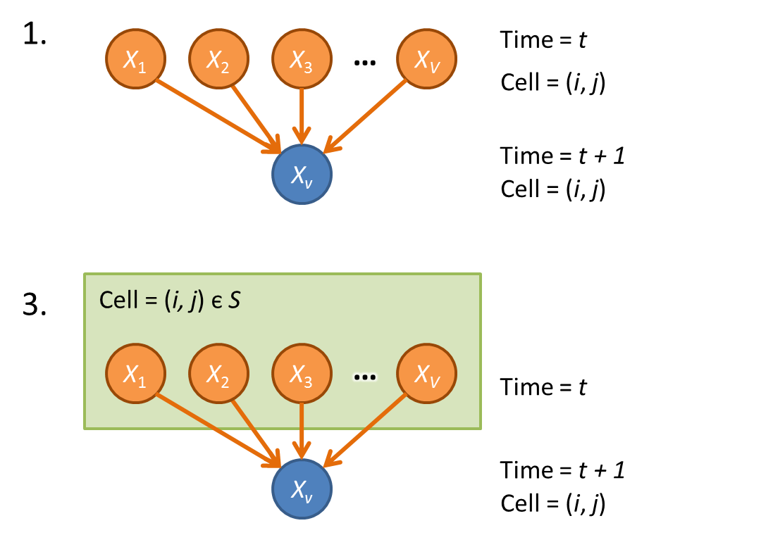
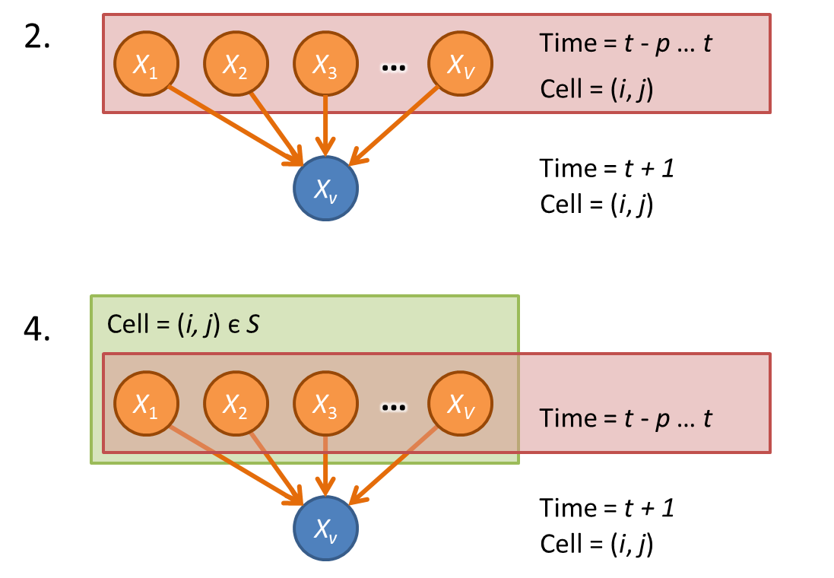
Forecasting task

Slide 7
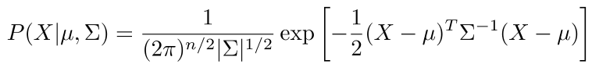
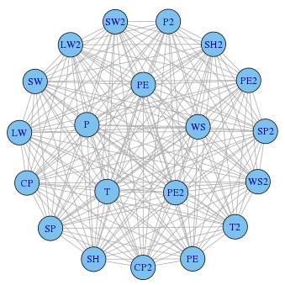
Gaussian Graphical Models
Learning Σ = Ω⁻¹:
Empirical covariance matrix
Neighborhood lasso (Meinshausen & Bulhmann, 2006)
Graphical lasso (Friedman et al., 2008)

Slide 8
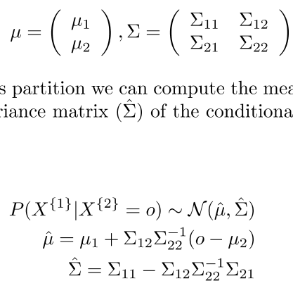
Gaussian Graphical Models
Inference:
Naïve matrix inversion
Belief propagation (graph with no cycles)
Loopy belief propagation (graph with cycles)
Enhanced belief propagation (Malioutov, 2008)

Slide 9
Weather Forecasting using Probabilistic Graphical Models
Spring 2014 – Probabilistic Graphical Models (10708)
Felipe Hernández and Amos Ng
Professor: Eric Xing
TA mentor: Dai Wei

